Slide 1
PCI Express
7 – July - 2020
Eng. # 3 SW Eng., James Hsiao

Slide 2
Agenda
Architecture
Configuration
Address Space & Transaction Routing
TLP Elements
Flow Control
DLLP Elements
ACK/NAK Protocol
Physical Layer – Logical
Link Initialization & Training
Power Management
Example

Slide 3
PCI Express
Architecture

Slide 4
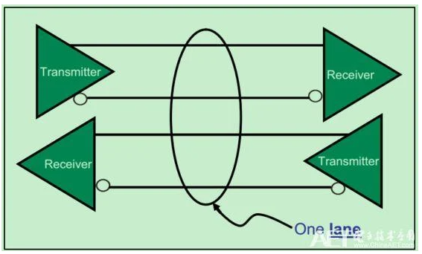
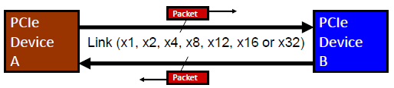
Architecture
Serial Transport
Links and Lanes
Dual Simplex point-to-point serial connection
Independent transmit and receive sides
Scalable Link Widths
x1, x2, x4, x8, x12, x16, x32
Scalable Link Speeds
2.5, 5.0, 8.0, 16.0 GT/s, 32GT/s
Packet based transaction protocol

Slide 5
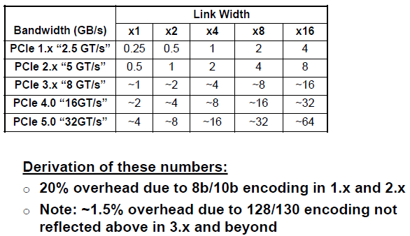
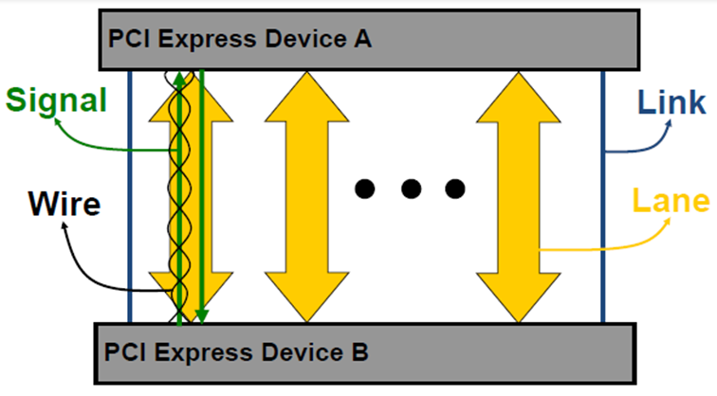
Architecture
Bandwidth

Slide 6
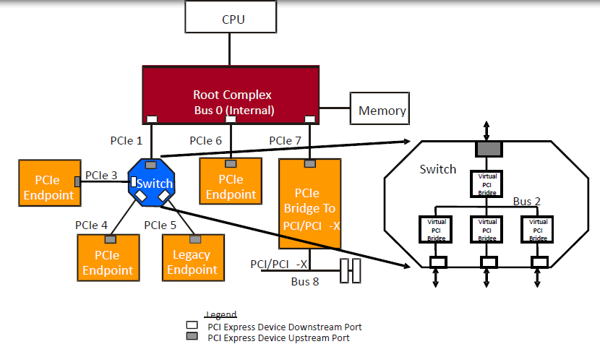
Architecture
Definitions
Root Complex denotes the root of an I/O hierarchy that connects the CPU/memory subsystem to the I/O.
A PCI Express to PCI/PCI-X Bridge provides a connection between a PCI Express fabric and a PCI/PCI-X hierarchy.
A Switch is defined as a logical assembly of multiple virtual PCI-to-PCI Bridge devices.
Endpoint refers to a type of Function that can be the Requester or Completer of a PCI Express transaction either on its own behalf or on behalf of a distinct non-PCI Express device (other than a PCI device or host CPU). Endpoints are classified as either legacy or PCI Express Endpoints.

Slide 7
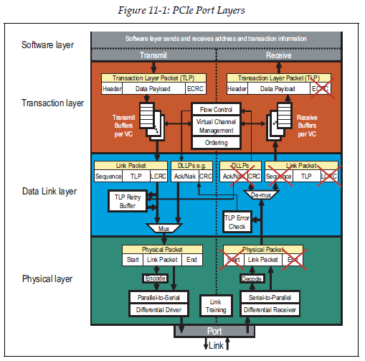
Architecture
Device Layers
The Transaction Layer’s primary responsibility is the assembly and disassembly of TLPs. TLPs are used to communicate transactions, such as read and write, as well as certain types of events. The Transaction Layer is also responsible for managing credit-based flow control for TLPs.
The Data Link Layer, serves as an intermediate stage between the Transaction Layer and the Physical Layer. The primary responsibilities of the Data Link Layer include Link management and data integrity, including error detection and error correction. The Data Link Layer also generates and consumes DLLPs that are used for Link management functions.
The Physical Layer includes all circuitry for interface operation, including driver and input buffers, parallel-to-serial and serial-to-parallel conversion, PLL(s), and impedance matching circuitry. It also includes logical functions related to interface initialization and maintenance. This Layer is responsible for converting information received from the Data Link Layer into an appropriate serialized format and transmitting it across the PCI Express Link at a frequency and width compatible with the device connected to the other side of the Link.
Notes:
Transaction Layer Packets (TLPs)
Data Link Layer Packets (DLLPs)

Slide 8
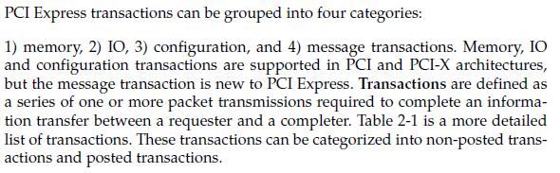
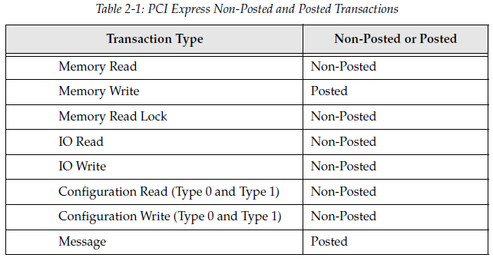
Architecture
Transaction
Transaction Type
Notes:
Lock: no other accesses are permitted to the target device
In PCI: LOCK#

Slide 9
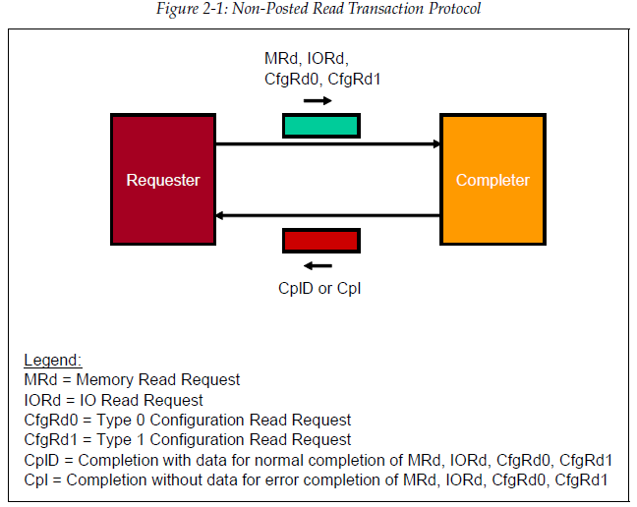
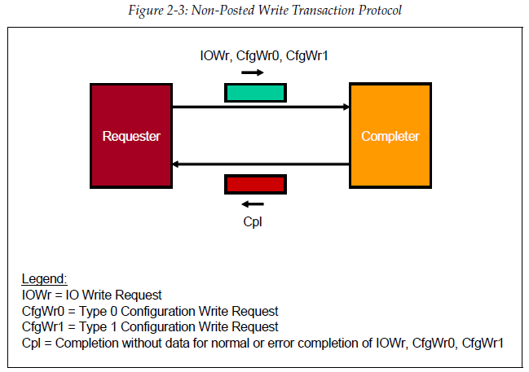
Architecture
Transaction
Non-Posted

Slide 10
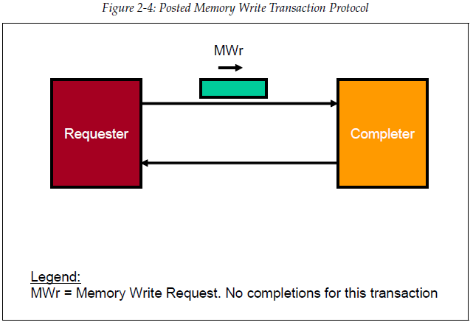
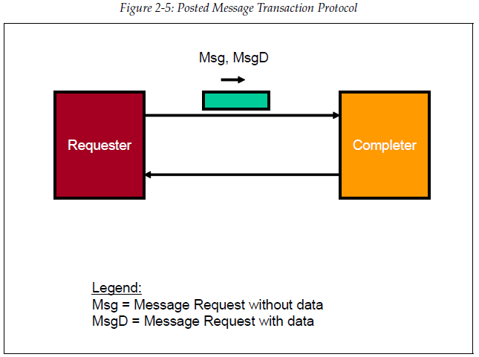
Architecture
Transaction
Posted

Slide 11
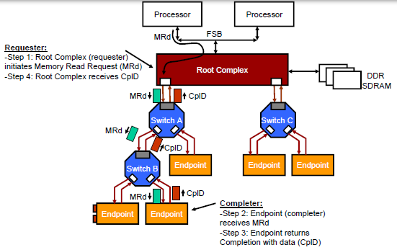
Architecture
Transaction
Programmed I/O Transaction

Slide 12
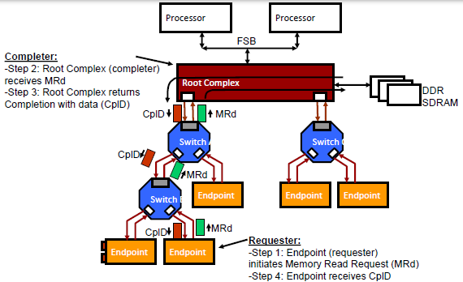
Architecture
Transaction
DMA Transaction

Slide 13
PCI Express
Configuration

Slide 14
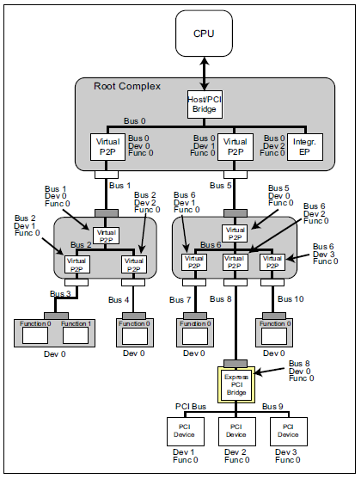
Configuration
Bus, Device and Function
Every PCIe Function is uniquely identified by the Device it resides within and the Bus to which the Device connects. This ID is commonly referred to as a ‘BDF’. Up to 256 Bus Numbers can be assigned by configuration software. The initial Bus Number, Bus 0, is typically assigned by hardware to the Root Complex. PCIe permits up to 32 device attachments on a single PCI bus. Each Device must implement Function 0 and may contain a collection of up to eight Functions. When two or more Functions are implemented the Device is called a multi-function device. These Functions may include hard drive interfaces, display controllers, ethernet controllers, USB controllers, etc. Each Function has its own configuration address space that is used to setup the resources associated with the Function.

Slide 15
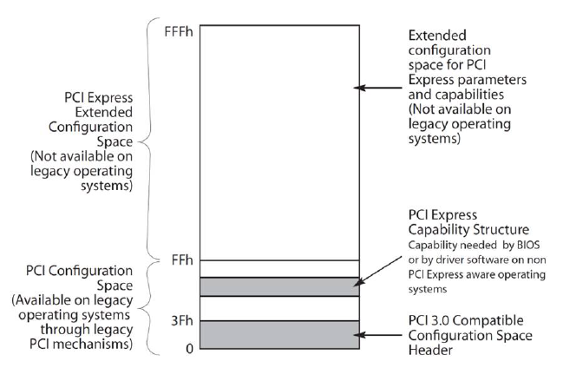
Configuration
Configuration Space
PCI Express extends the Configuration Space to 4096 bytes per Function as compared to 256 bytes allowed by PCI. PCI Express Configuration Space is divided into a PCI-compatible region, which consists of the first 256 bytes of a Function’s Configuration Space, and a PCI Express Extended Configuration Space which consists of the remaining Configuration Space.

Slide 16
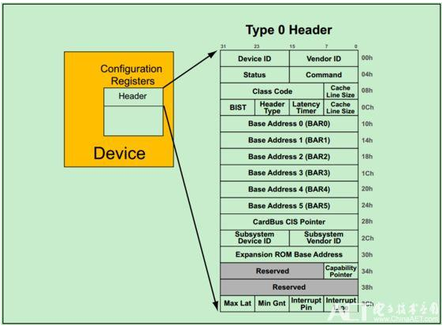
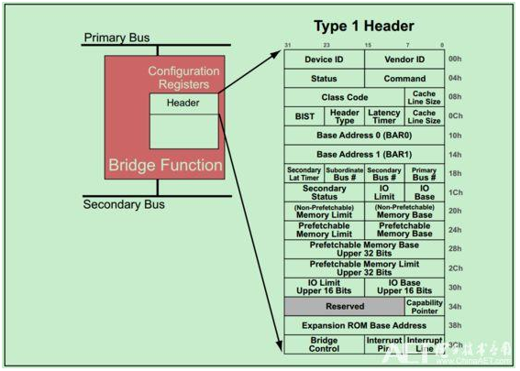
Configuration
PCI-Compatible Configuration Space

Slide 17
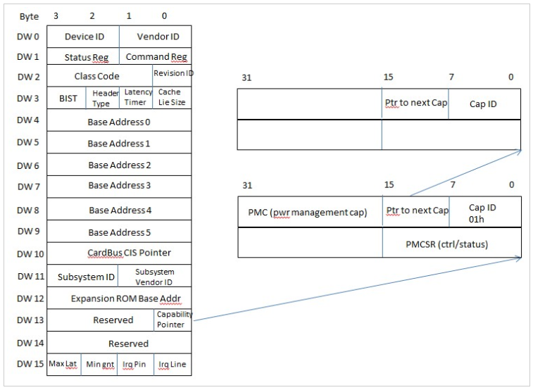
Configuration
PCI-Compatible Configuration Space
Notes:
During enumeration, system software will read capability register sets of device. Lower 8bit of DW#13 in config space is the capability pointer. It points to the 1st set of capability registers. Bit15 to 8 of the 1st capability register is the pointer pointing to the next one. For power management capability register, capability ID, lower 8bit of the 1st DW, is 01h which indicates it is power management capability register set.

Slide 18
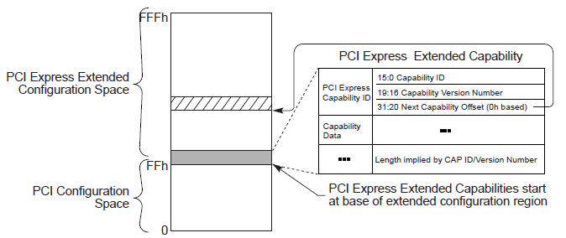
Configuration
Extended Configuration Space

Slide 19
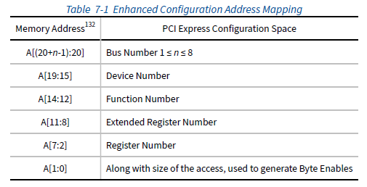
Configuration
Enhanced Configuration Access Mechanism

Slide 20
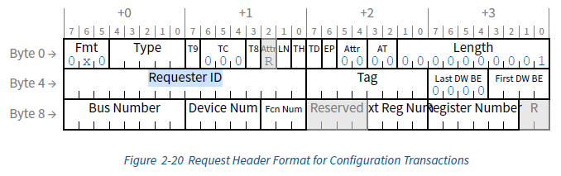
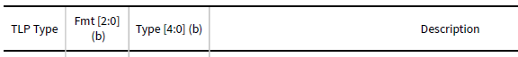
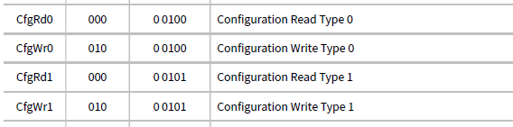
Configuration
Configuration Requests

Slide 21
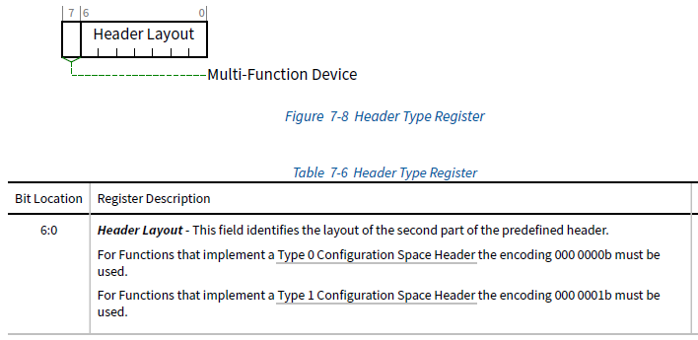
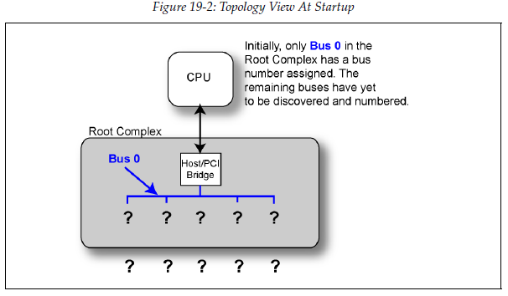
Configuration
Enumeration – Discovering the Topology

Slide 22
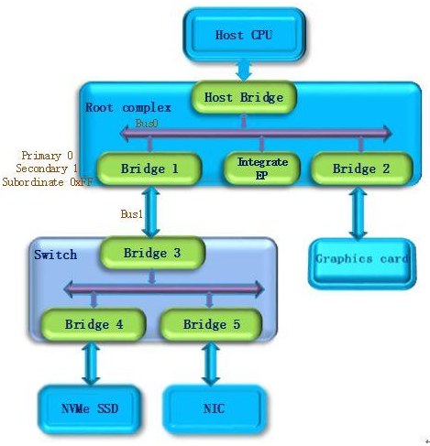
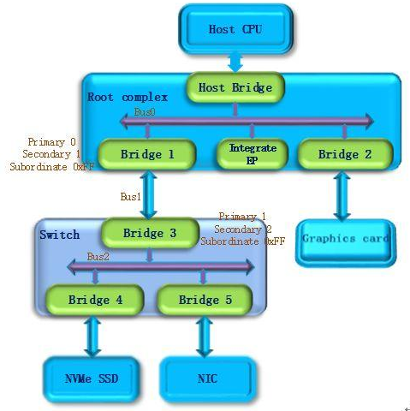
Configuration
Enumeration Example

Slide 23
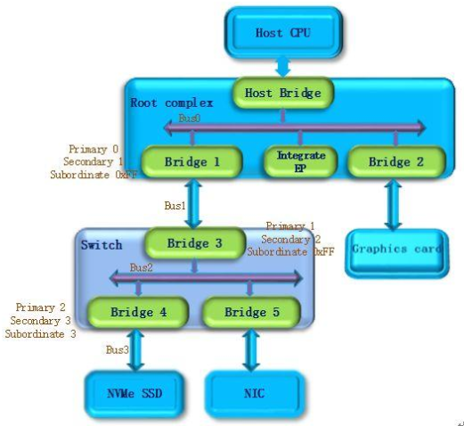
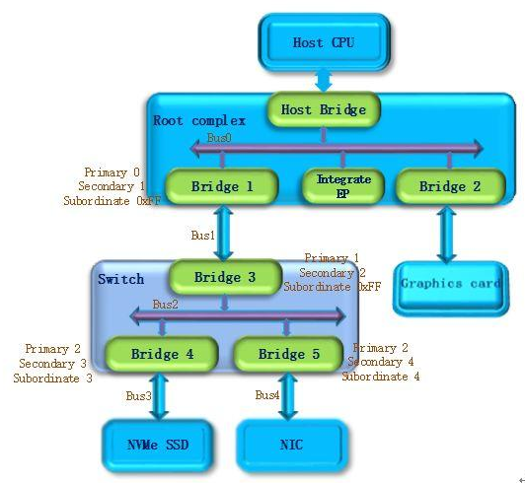
Configuration
Enumeration Example

Slide 24
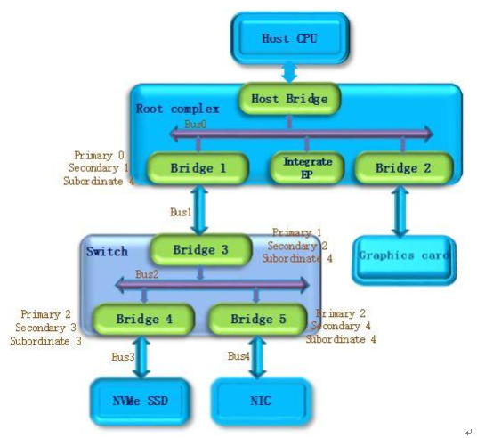
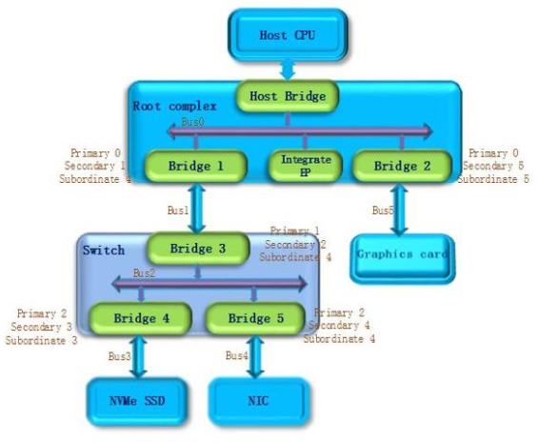
Configuration
Enumeration Example

Slide 25
PCI Express
Address Space & Transaction Routing

Slide 26
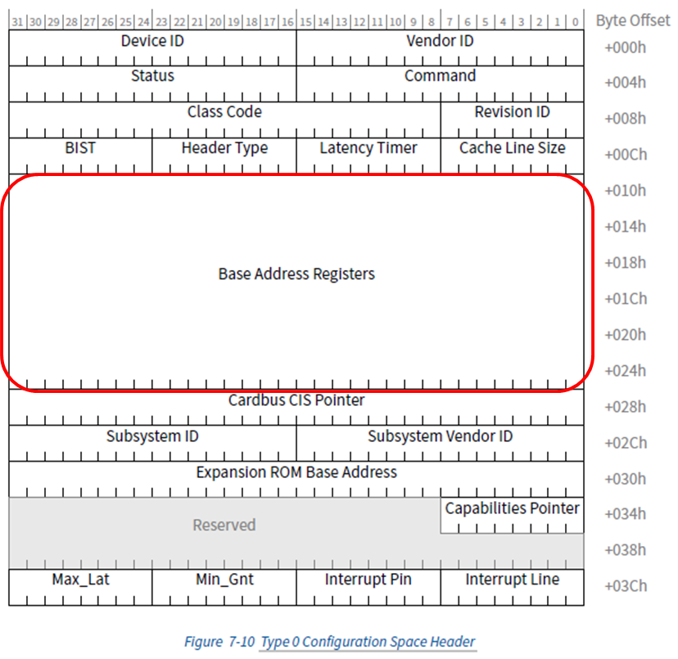
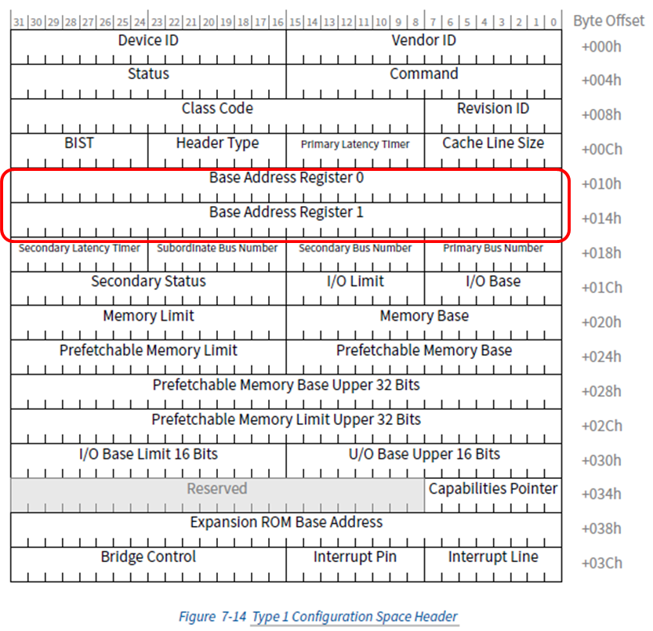
Address Space & Transaction Routing
Base Address Registers (BARs)
Notes:
System software must build a consistent address map before booting the machine to an operating system. This means it has to determine how much memory is in the system, and how much address space the Functions in the system require. After determining this information, system software can map the Functions into reasonable locations and proceed with system boot. In order to do this mapping in a device-independent manner, the base registers for this mapping are placed in the predefined header portion of Configuration Space.

Slide 27
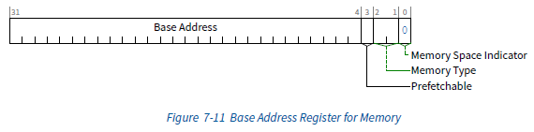
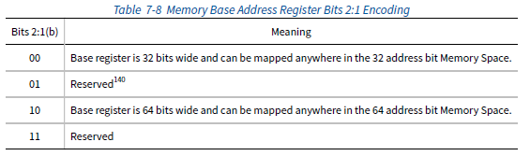
Address Space & Transaction Routing
Base Address Registers (BARs)
Notes:
Bit 0 in all Base Address registers is read-only and used to determine whether the register maps into Memory or I/O
Space. Base Address registers that map to Memory Space must return a 0b in bit 0
副作用就是指讀取某個地址時可能導致該地址內容發生變化，訪問不可預取記憶體時就不能進行優化，因為每次訪問都伴隨副作用，就和I/O埠一樣。將其控制暫存器對映到記憶體地址範圍的外設會把該範圍置為不可預取

Slide 28
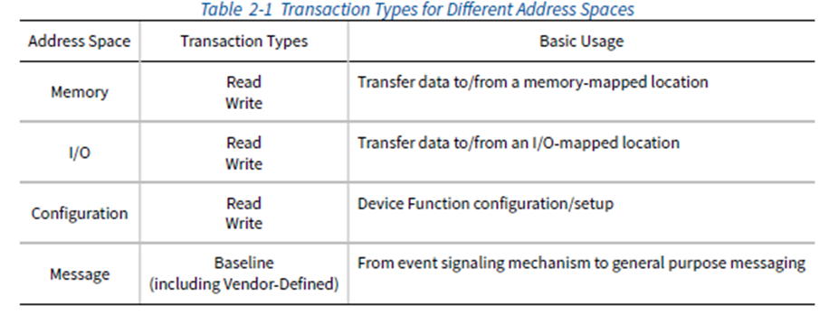
Address Space & Transaction Routing
TLP Routing Basics
Request are translated to one of four transaction types by the Transaction Layer:
Memory Read or Memory Write: Used to transfer data from or to a memory mapped location.
–The protocol also supports a locked memory read transaction variant
I/O Read or I/O Write: Used to transfer data from or to an I/O location.
–These transactions are restricted to supporting legacy endpoint devices
Configuration Read or Configuration Write: Used to discover device capabilities, program features, and check status in the 4KB PCI Express configuration space.
Messages: Handled like posted writes. Used for event signaling and general purpose messaging.
Notes:
For any TLP, a value of 1b in the TD bit indicates the presence of the TLP Digest field including an end-to-end
CRC (ECRC) value at the end of the TLP.

Slide 29
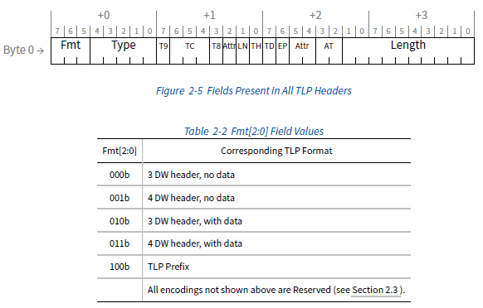
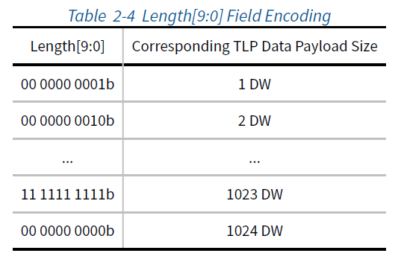
Address Space & Transaction Routing
TLP Routing Basics

Slide 30
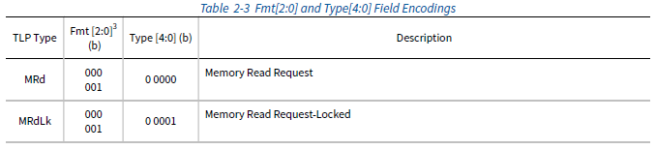
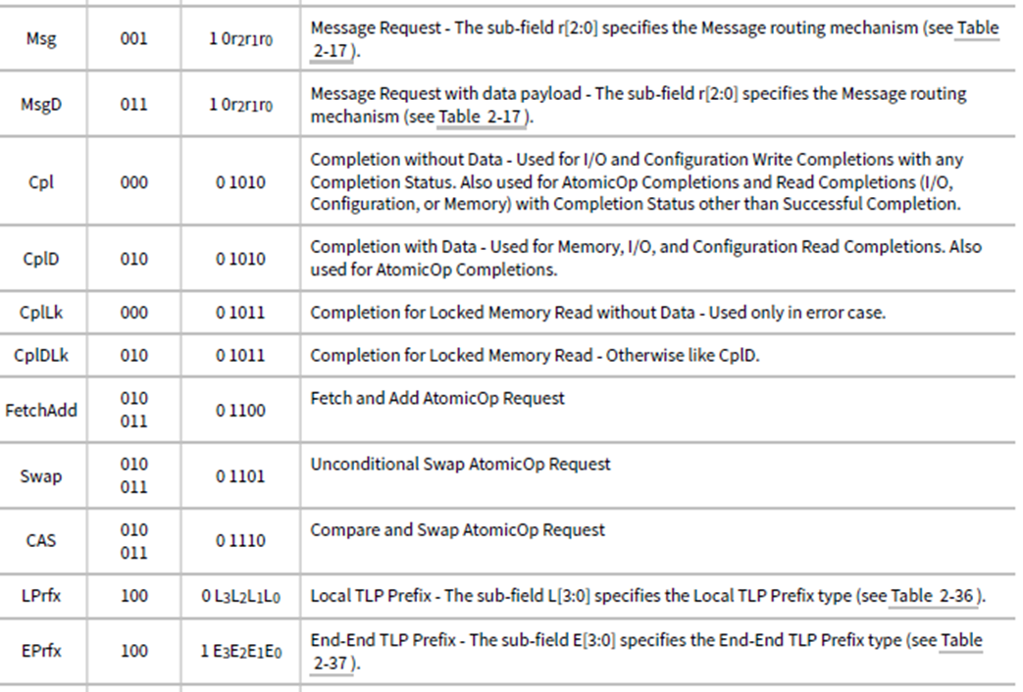
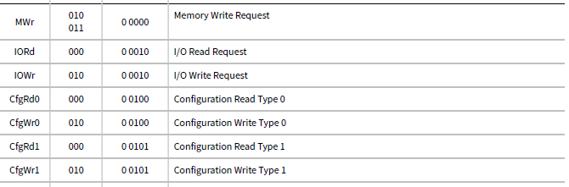
Address Space & Transaction Routing
TLP Routing Basics

Slide 31
Address Space & Transaction Routing
Applying Routing Mechanisms
Each request or completion header is tagged as to its type, and each of the packet types is routed based on one of three schemes:
•Address Routing
•ID Routing
•Implicit Routing
Memory and IO requests use address routing
Completions and Configuration cycles use ID routing
Message requests have selectable routing based on a 3-bit code in the message routing sub-field of the header type field

Slide 32
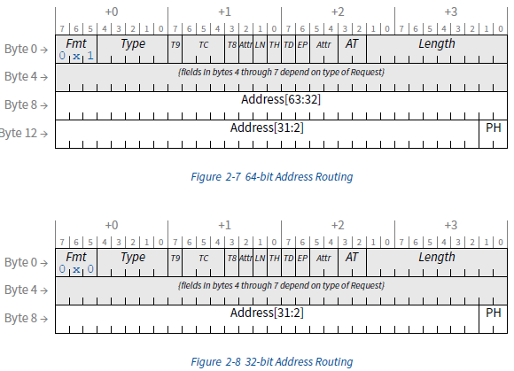
Address Space & Transaction Routing
Applying Routing Mechanisms
Address Routing
Notes:
TLP Hints (TH) - 1b indicates the presence of TLP Processing Hints (TPH) in the TLP header
If TH is Set, the PH field is encoded as shown in Table 2-15 . If TH is Clear, the PH field is Reserved.
Processing Hint Encoding

Slide 33
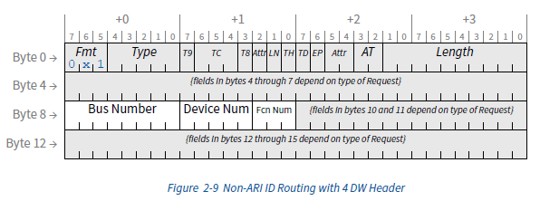
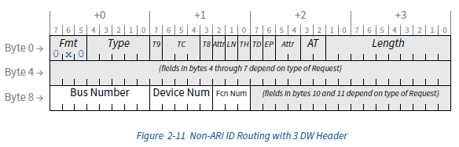
Address Space & Transaction Routing
Applying Routing Mechanisms
ID Routing
Notes:
In ARI (Alternative Routing-ID) Devices, Functions are only required to capture the Bus Number. ARI Devices are permitted to retain the captured Bus Number on either a per-Device or a per-Function basis. If the captured Bus Number is retained on a per-Device basis, all Functions are required to update and use the common Bus Number.

Slide 34
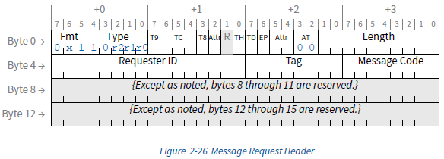
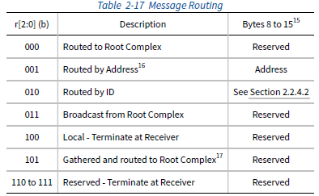
Address Space & Transaction Routing
Applying Routing Mechanisms
Implicit Routing
Notes:
“implicit” because no address or ID specifies the destination, but rather the destination is implied by the
routing type.
Implicit routing is used only with Message Requests, and is covered in Section 2.2.8

Slide 35
PCI Express
TLP Elements

Slide 36
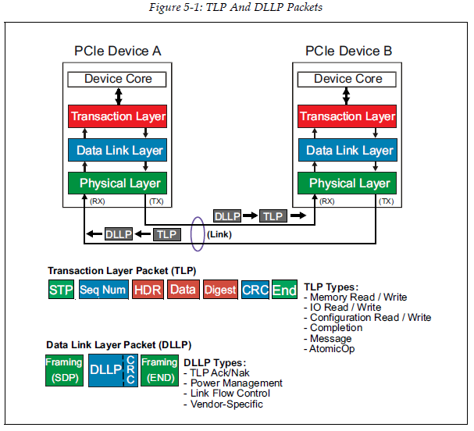
TLP Elements
Packet-Based Protocol

Slide 37
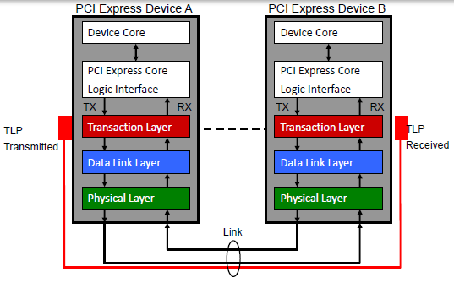
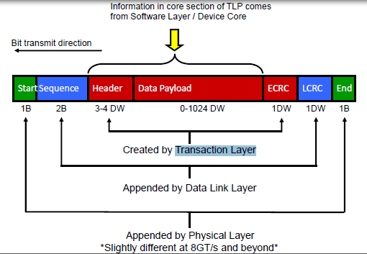
TLP Elements
TLP Assembly And Disassembly

Slide 38
PCI Express
Flow Control

Slide 39


Flow Control
Concept

Slide 40

Flow Control
Buffers and Credits

Slide 41


Flow Control
Advertisement

Slide 42


Flow Control
Initialization Sequence

Slide 43


Flow Control
FC_Init1 & FC_Init2

Slide 44

Flow Control
Example of Flow Control Initialization
Notes:
Figure 3-3 illustrates an example of the Flow Control initialization protocol for VC0 between a Switch and a
Downstream component. In this example, each component advertises the minimum permitted values for each
type of Flow Control credit. For both components the largest Max_Payload_Size value supported is 1024 bytes,
corresponding to a data payload credit advertisement of 040h. All DLLPs are shown as received without error.

Slide 45


Flow Control
UpdateFC

Slide 46
PCI Express
DLLP Elements

Slide 47

DLLP Elements
Sending DLLPs

Slide 48

DLLP Elements
DLLP Packet Types

Slide 49
PCI Express
ACK/NAK Protocol

Slide 50


ACK/NAK Protocol
Overview

Slide 51

ACK/NAK Protocol
Elements

Slide 52
PCI Express
Physical Layer - Logical

Slide 53


Physical Layer - Logical
Mux and Control Logic

Slide 54


Physical Layer - Logical
Packet Format

Slide 55


Physical Layer - Logical
8b/10b Encoding

Slide 56

Physical Layer - Logical
Ordered-Set Origin and Destination

Slide 57

Physical Layer - Logical
Ordered-Set Structure

Slide 58
PCI Express
Link Initialization & Training

Slide 59


Link Initialization & Training
Overview
The following are discovered and determined during the training process:
• Link width
• Link data rate
• Lane reversal
• Lane polarity

Slide 60


Link Initialization & Training
TS1 and TS2 Ordered Sets

Slide 61

Link Initialization & Training
Link Training and Status State Machine (LTSSM)
Overview

Slide 62

Link Initialization & Training
Link Training and Status State Machine (LTSSM)
Detect

Slide 63

Link Initialization & Training
Link Training and Status State Machine (LTSSM)
Polling

Slide 64

Link Initialization & Training
Link Training and Status State Machine (LTSSM)
Configuration
Link and Lane Number

Slide 65

Link Initialization & Training
Link Training and Status State Machine (LTSSM)
Configuration
Link Configuration Example 1

Slide 66


Link Initialization & Training
Link Training and Status State Machine (LTSSM)
Configuration
Link Configuration Example 1

Slide 67

Link Initialization & Training
Link Training and Status State Machine (LTSSM)
Configuration
Link Configuration Example 2

Slide 68


Link Initialization & Training
Link Training and Status State Machine (LTSSM)
Configuration
Link Configuration Example 2
Notes:
Implicit routing is used only with Message Requests, and is covered in Section 2.2.8

Slide 69


Link Initialization & Training
Link Training and Status State Machine (LTSSM)
Configuration
Link Configuration Example 3: Failed Lane
Notes:
Implicit routing is used only with Message Requests, and is covered in Section 2.2.8

Slide 70

Link Initialization & Training
Link Training and Status State Machine (LTSSM)
Configuration
Link Configuration Example 3: Failed Lane
Notes:
Implicit routing is used only with Message Requests, and is covered in Section 2.2.8

Slide 71

Link Initialization & Training
Link Training and Status State Machine (LTSSM)
Configuration

Slide 72
Link Initialization & Training
Link Training and Status State Machine (LTSSM)
L0

Slide 73

Link Initialization & Training
Link Training and Status State Machine (LTSSM)
Recovery

Slide 74


Link Initialization & Training
Link Training and Status State Machine (LTSSM)
Recovery
Link Equalization

Slide 75


Link Initialization & Training
Link Training and Status State Machine (LTSSM)
Recovery
Link Equalization

Slide 76


Link Initialization & Training
Link Training and Status State Machine (LTSSM)
Recovery
Link Equalization

Slide 77


Link Initialization & Training
Link Training and Status State Machine (LTSSM)
L0s

Slide 78

Link Initialization & Training
Link Training and Status State Machine (LTSSM)
L1

Slide 79

Link Initialization & Training
Link Training and Status State Machine (LTSSM)
L2

Slide 80


Link Initialization & Training
Dynamic Bandwidth Changes
Dynamic Link Speed Changes
Notes:
To improve power consumption
To resolve reliability problems

Slide 81


Link Initialization & Training
Dynamic Bandwidth Changes
Dynamic Link Speed Changes

Slide 82


Link Initialization & Training
Dynamic Bandwidth Changes
Dynamic Link Width Changes

Slide 83


Link Initialization & Training
Dynamic Bandwidth Changes
Dynamic Link Width Changes

Slide 84

Link Initialization & Training
Dynamic Bandwidth Changes
Dynamic Link Width Changes

Slide 85
PCI Express
Power Management

Slide 86

Power Management
Function Power Management
PM States
Notes:
PCIE supports four device power states (ACPI), D0, D1, D2, and D3. D0 is mandatory and is full-on state. D0 has D0 uninitialized and D0 active two sub-states. D1 and D2 are optional. D1 is light sleep and D2 is deep sleep. D3 is mandatory and is the lowest device power state. D3 is full-off state and has D3cold(w.o. Vcc) and D3hot(w. Vcc.) two sub-states.

Slide 87



Power Management
Function Power Management
PCI-PM Registers
Notes:
Bit31 to 16 of the 1st DW is PMC, power management capabilities. This is determined by device design. At enumeration, system software reads this 16bit to know device PM capability. Inside PMC, [2:0] is version. [3] is PME clock. [3]=1 indicates pcie refclk is needed by device to generate PME. [9] is D1_support. [9]=1 indicates device supports D1. Strictly speaking we should say [9]=1 indicates FUNCTION supports D1. This is because a pcie device may have multiple functions. [10] is D2_support. [10]=1 indicates function supports D2. [15:11] is PME_support indicating in which power states the function can send a PME message. Bit[15:11] correspond to D3cold, D3hot, D2, D1, and D0 state.
After system software, aka, system driver, reads PMC, it can program [1:0] of PMCSR to put function into different power states. Driver can also read PMCSR[1:0] to know the device state status. Driver can program PMCSR[2]=1 to enable function to generate PME#. PMCSR[15] is PME_status bit and driver reads this bit to query function PME event status
Data: optional, 8-bit read-only, Power Consumption/Dissipation(thermal), Units: Watts

Slide 88

Power Management
Link Power Management
State Flow Diagram
Notes:
By the time PCI Express was developed in 2002, additional “Link States,” or “L-States,” were included in the specification. These follow the template of the existing “D-States.” “L0” reflects a PCI Express link in full operation. “L1” is a link which is not transferring data but which can relatively quickly resume normal operation. “L2” and “L3” each reflect a link with main power removed (“L2” indicates an auxiliary power supply is active to provide “keep alive” power to devices). An “L0s” state was also defined in which each direction of the PCI Express link could be shut down independently with a quick resumption to normal operation. Fully active devices in “D0” can transition between “L0”, “L0s” and “L1” with no software intervention and thus save power on their own initiative without any operating system interaction.

Slide 89

Power Management
Link Power Management
Relation Between Power Management States of Link and Components

Slide 90

Power Management
Link Power Management
State Characteristics

Slide 91


Power Management
Active State Power Management (ASPM)
L0s State
L0s, also called L0 standby. Mandatory for all pcie devices. Los I applied to a single direction of pcie link. So if device initiates L0s, device can put its tx into L0s while its rx is still in L0.
When either system or device side pcie phy hardware detects idle time on pcie link, it can put its tx into L0s state. It doesn’t need to tell higher layer software to block outbound TLP transactions. L0s exit is also initiated by the corresponding phy hw.
Notes:
Pcie device low power states require system driver to explicitly put device into low power states and pcie link can in turn go into low power link states. Pcie spec allows pcie link to go to low power states without system driver get involved. This feature is the so-called Active State Power Management (ASPM). In general, either system driver side hardware or device hardware can for example detect some idle time on pcie link and then initiate transition to move

Slide 92

Power Management
Active State Power Management (ASPM)
L1 ASPM State
Notes:
L1 entrance is different since L1 needs both directions to end up in L1. Below is how device requests the link to get into ASPM L1:
Device phy detects certain idle time on pcie link. Note this idle time is implementation dependent and is normally 7-10us. Device then blocks new outbound transaction to system.
Device keeps sending PM_Active_State_Request_L1 DLLP to system side until it receives PM_Request_ACK from system side.
System receives PM_Active_State_Request_L1, blocks new transaction to device, keeps sending PM_Request_ACK until receives electrical idle ordered set.
Device receives PM_Request_ACK, sends electrical idle ordered set, and puts its tx into electrical idle
System receives electrical idle, puts its tx into electrical idle. Now Pcie link is in ASPM L1 state.
Either system or device can initiate ASPM L1 exit.

Slide 93

Power Management
Software Initiated Device Power Management
L1 State

Slide 94


Power Management
Software Initiated Device Power Management
L2/L3 Ready

Slide 95

Power Management
Power Management Event Mechanisms
PME Message

Slide 96


Power Management
Power Management Event Mechanisms
Link Wake

Slide 97


Power Management
L1 PM Substates
State Diagram
Notes:
Conventional L1 state is also the new L1.0 substate.
L1.1 consumes lower power than L1.0. This is because pcie ports are not required to be enabled to detect electrical idle. But pcie link common mode voltages are still maintained.
L1.2 is even lower power than L1.1 since link common mode voltages are not maintained.
Both L1.1 and L1.2 requires a bidirectional open-drain CLKREQ# for entry to and exit from the state.

Slide 98


Power Management
L1 PM Substates
Entry conditions
The following rules define how the L1.1 and L1.2 substates are entered:
When in PCI-PM L1.0 and the PCI-PM L1.2 Enable bit is Set, the L1.2 substate must be entered when CLKREQ# is deasserted.
When in PCI-PM L1.0 and the PCI-PM L1.1 Enable bit is Set, the L1.1 substate must be entered when CLKREQ# is deasserted and the PCI-PM L1.2 Enable bit is Clear.
When in ASPM L1.0 and the ASPM L1.2 Enable bit is Set, the L1.2 substate must be entered when CLKREQ# is deasserted and the reported LTR value last sent or received by this Port is greater than or equal to the value set by the LTR_L1.2_THRESHOLD Value and Scale fields.
When in ASPM L1.0 and the ASPM L1.1 Enable bit is Set, the L1.1 substate must be entered when CLKREQ# is deasserted and the conditions for entering the L1.2 substate are not satisfied.

Slide 99
PCI Express
Example

Slide 100

Example
Enumeration
PCI Map

Slide 101

Example
PCI Config
Header0

Slide 102

Example
PCI Config
PCIe Capability

Slide 103

Example
NVMe
Controller Registers

Slide 104

Example
Enumeration
PCI Map

Slide 105

Example
PCI Config

Slide 106

Example
PCI Config

Slide 107

Example
NVMe
Set Features

Slide 108

Example
NVMe
Identify Controller

Slide 109

Example
NVMe
Read command

Slide 110
PCI Express
Q & A

Slide 111


Architecture
Device Layers
The Transaction Layer’s primary responsibility is the assembly and disassembly of TLPs. TLPs are used to communicate transactions, such as read and write, as well as certain types of events. The Transaction Layer is also responsible for managing credit-based flow control for TLPs.
The Data Link Layer, serves as an intermediate stage between the Transaction Layer and the Physical Layer. The primary responsibilities of the Data Link Layer include Link management and data integrity, including error detection and error correction. The Data Link Layer also generates and consumes DLLPs that are used for Link management functions.
The Physical Layer includes all circuitry for interface operation, including driver and input buffers, parallel-to-serial and serial-to-parallel conversion, PLL(s), and impedance matching circuitry. It also includes logical functions related to interface initialization and maintenance. This Layer is responsible for converting information received from the Data Link Layer into an appropriate serialized format and transmitting it across the PCI Express Link at a frequency and width compatible with the device connected to the other side of the Link.

Slide 112

Architecture
Transaction
Peer-to-Peer Transaction

Slide 113

Address Space & Transaction Routing
Base Address Registers (BARs)

Slide 114

Address Space & Transaction Routing
Base Address Registers (BARs)
Notes:
F900_0000h – F900_0FFFh (4KB in size)

Slide 115


Address Space & Transaction Routing
TLP Routing Basics

Slide 116

TLP Elements
TLP Assembly And Disassembly

Slide 117


Physical Layer - Logical
Byte Striping

Slide 118


Physical Layer - Logical
Scrambler

Slide 119

Link Initialization & Training
Overview

